Slide 1

Pearson students data:
Insights
Poznań, 20th of October, 2016

Slide 2
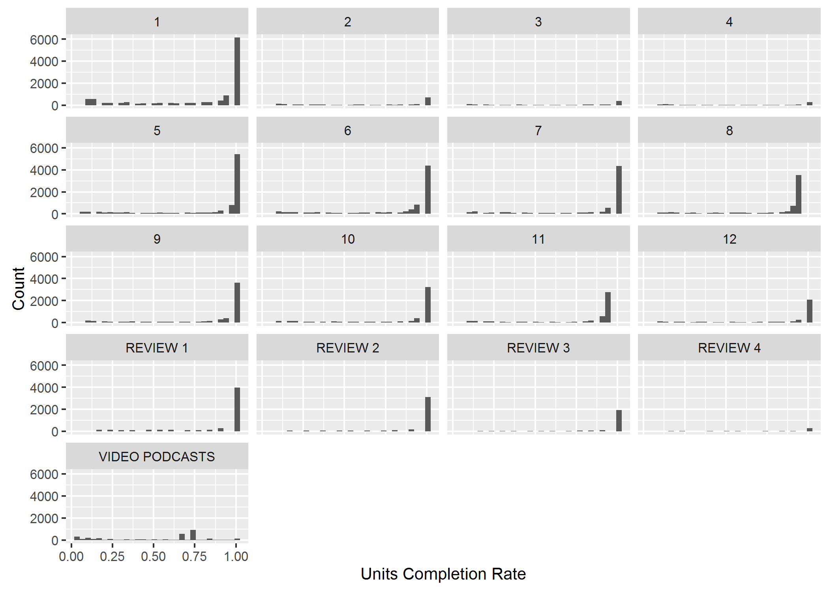
Some units require improvements
UNITS 2, 3, 4 and REVIEW 4 require special attention. Much less students start and complete them in comparison to other units.

Slide 3
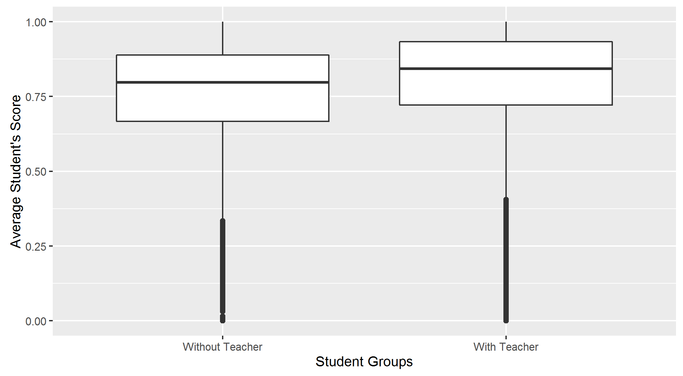
Teachers can improve student’s scores
Average tutored student have mean score 0.04 higher than untotored student.
Notes:
Use multiple points, if necessary.

Slide 4
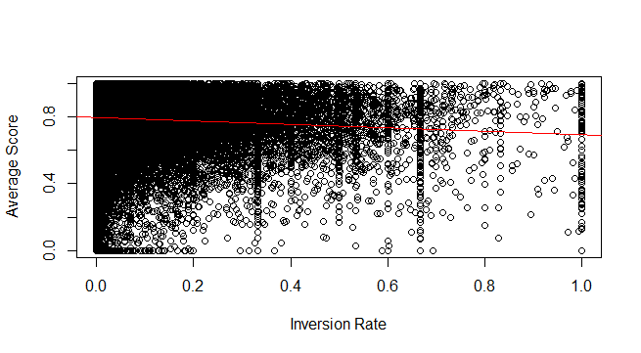
The higher inversion rate, the lower the scores
Reversing order of learning has negative impact on students’ score.
Notes:
Use brief bullets and discuss details verbally.

Slide 5
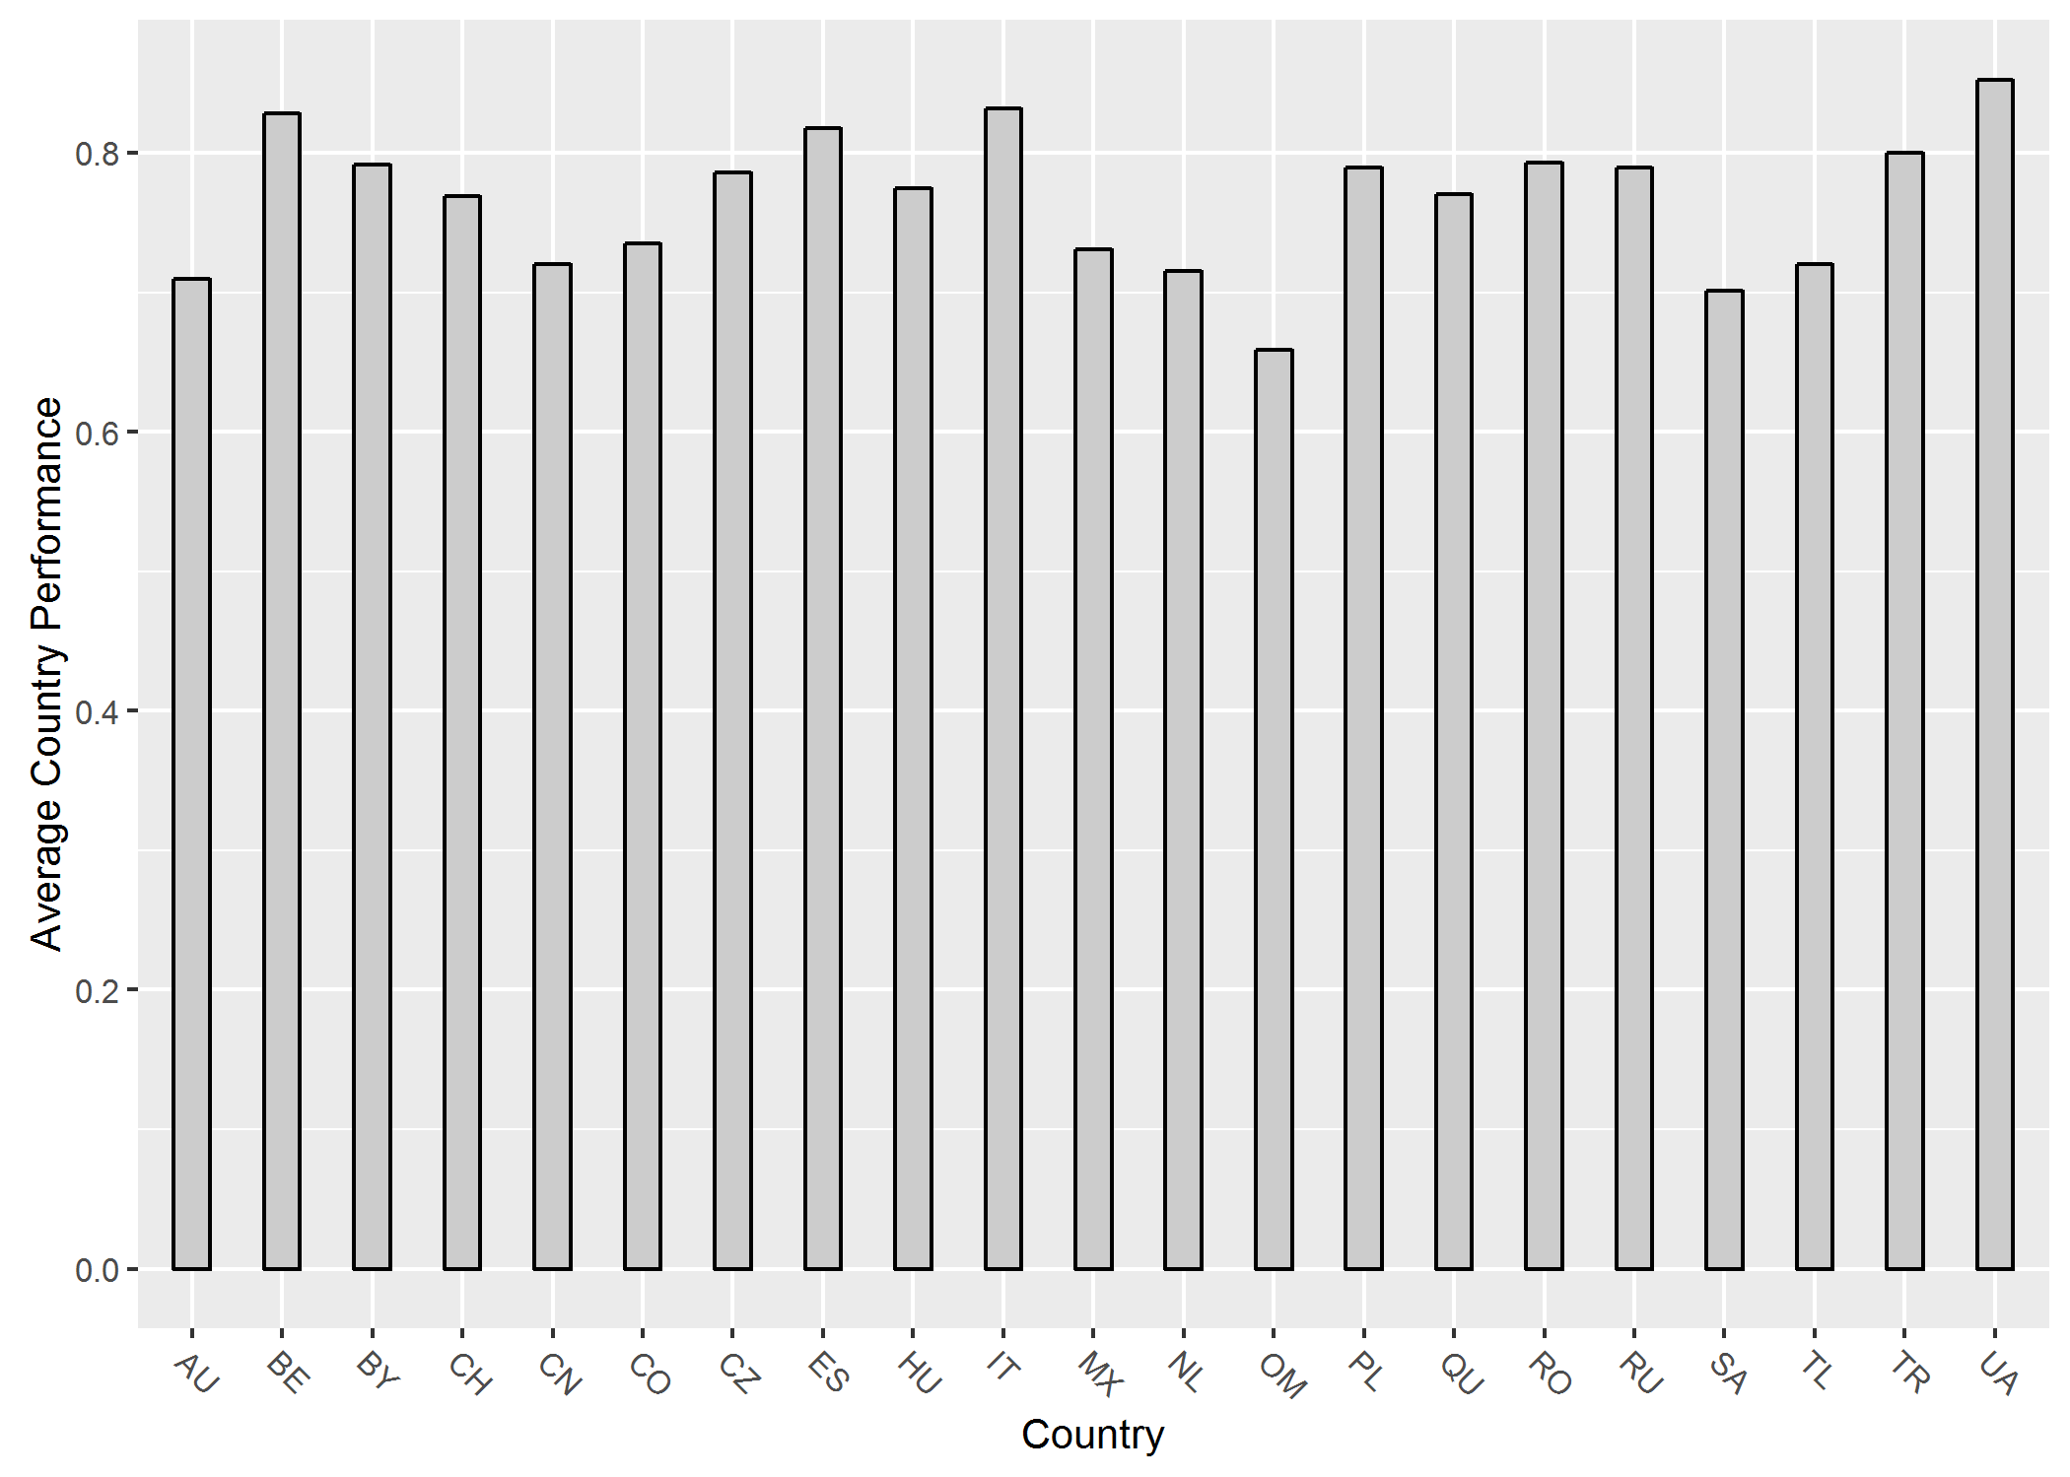
Some countries are better than the other
Perhaps cultural differences should be considered when designing learning materials.

